Slide 1

ZOMATO
RESTAURANTS ANALYSIS
Lukose Jacob
18th May 2025

Slide 2



INTRODUCTION
Zomato’s mission to “bring great food to more people” is not just about discovering good meals; it’s about delivering meaningful dining experiences where they’re needed most.
But with over 9,500 restaurants spanning 15 countries, where should it expand next?
This project uses data to identify the best markets for growth.
The goal is to analyze restaurant performance across countries and cities and recommend where and how to expand.
Ultimately, the objective is to use data to help Zomato grow in the right places, with the right offerings, at the right time.

Slide 3

DATA SNAPSHOT
DATA ENRICHMENT
Added Cuisine_Count column to reflect number of cuisines per restaurant
Captured multi-cuisine offerings by restaurants
Used XLOOKUP to fetch country names based on country codes
Joined the mapping table accurately with the main data
Created Customized_Price column using string functions:
Extracted currency symbol (e.g., ₹, $, AED)
Appended it with average cost for two
This provided a cleaner, presentation-ready price field (e.g., ₹ 250)
Datekey_Opening was in not in proper date format
Extracted year component into new column Year_Opening
Enabled time-based analysis (e.g., growth trend)
WHY THIS MATTERS
Clean data eliminates noise and default bias
Creates a solid foundation for accurate insights and decision-making
Enriched columns enable custom visuals, slicer filters, and advanced analysis
Raw data doesn’t speak clearly on its own. We have to clean it, enrich it, and give it structure so that every value could contribute to a story. Only when data is tidy and organized can it tell us where to go and how to grow.
DATASET STRUCTURE
Table 1: Restaurant Table
Contains 9,551 restaurant records from 15 countries
Includes 20 attributes
Table 2: Country Mapping Table
DATA CLEANING AND PREPROCESSING
Identified 498 rows with invalid coordinates(0,0)
Replaced with "Missing"
New helper column Location_Valid created with Yes/No
Replaced missing entries in Cuisine column with "Missing" for consistency
Flagged Avg_cost_for_two using a new column Valid_Price for filtering inaccurate cost data
Removed non-informative column Switch_to_order_menu which had only “No” across all rows

Slide 4
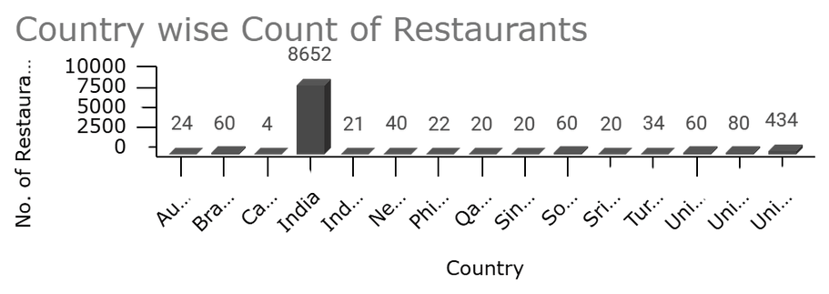
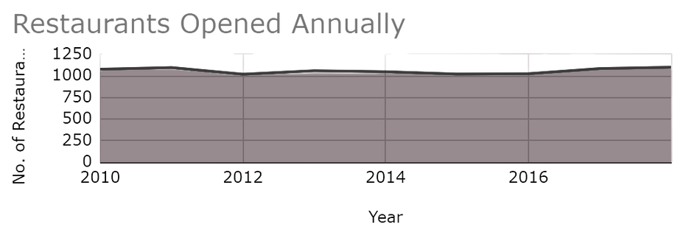
CURRENT DISTRIBUTION
Now that we understood what the data is lets try to identify where are restaurants currently located? The data revealed an imbalance with some countries overserved and others barely tapped. By visualizing these patterns, we begin to see gaps and opportunities emerge.
India and USA have the highest number of restaurants, suggesting market saturation.
Countries with < 55 restaurants (below 75th percentile) show low competition.
Time-series analysis using Year_Opening reveals steady global expansion trends.
Underrepresented countries emerged as potential whitespace markets.

Slide 5
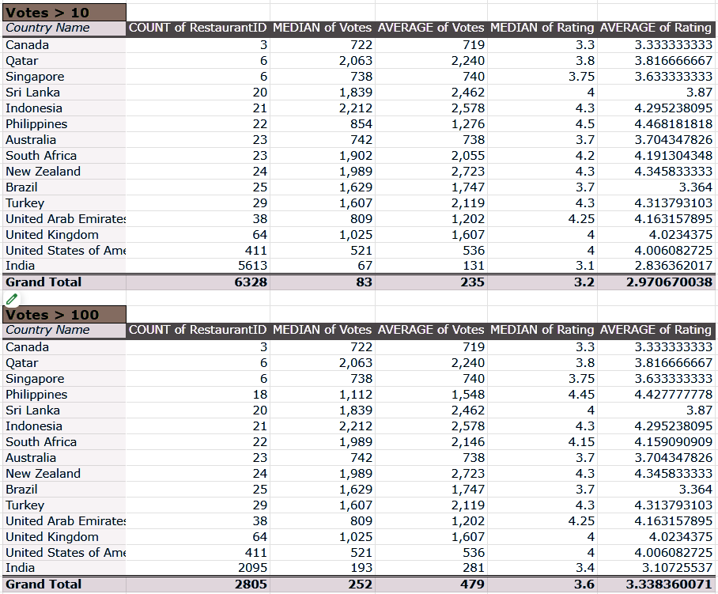
But location alone doesn’t tell us enough. We needed to know: Are people even engaging with these restaurants? Filtering by meaningful votes showed us where customers are active and responsive and where they’re not.
CUSTOMER
ENGAGEMENT
The dataset consists of details regarding 9551 restaurants.
Out of this only 6328(~66%) restaurants have received more than 10 votes indicating that almost one third of the restaurants have very minimal customer engagement.
And further analysis shows that only 2805(~29%) restaurants have votes > 100.
Focusing on these restaurants can provide a more clearer picture of genuinely well received establishments.
Restaurants with 0 votes were rated 1 by default which could easily skew the data and cause inconstistencies.

Slide 6

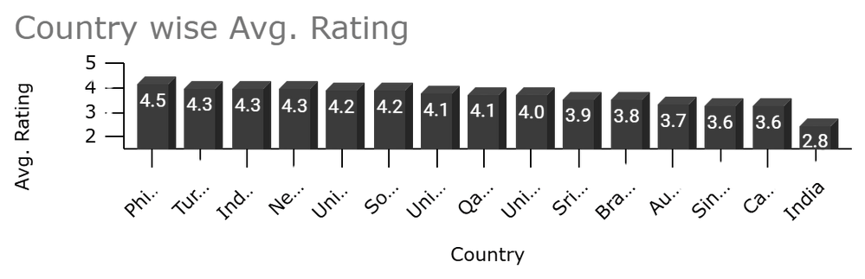
CUSTOMER SATISFACTION
Once we understood engagement, we brought in ratings and restaurant counts. The data was ready to speak more clearly helping us classify countries into expansion-ready, saturated, or inactive.
This is where strategy starts to take form.
Median and average ratings were used to identify customer satisfaction trends.
Countries with Ratings > 4.0 and Votes > 100 emerged as high-potential markets.
Low-rated markets with high votes suggest opportunities for disruption.
Countries with high average ratings and low restaurant count are underutilized but loved.
Countries with skewed vote distributions were flagged for further revie.
Inactive or low-rated countries with low engagement were excluded from the shortlist.
Balanced markets with aligned votes and ratings were prioritized for immediate scaling.

Slide 7
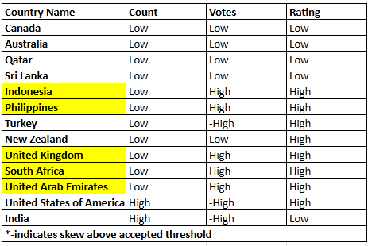
HIGH-POTENTIAL
COUNTRIES
Now that we know where restaurants are located, where people are engaged, and where customers are satisfied the pieces begin to align. It’s time to connect the dots and ask: Where should Zomato go next?
The answer lies in strategic segmentation backed by data, not guesswork.
To identify the most promising countries for expansion, a multi-dimensional segmentation approach was used combining restaurant count, engagement (votes), and customer satisfaction (ratings).
A liberal threshold strategy was applied.
Indonesia, Philippines, UK, South Africa and UAE are the countries that demonstrate high satisfaction and engagement despite a low restaurant footfall.

Slide 8
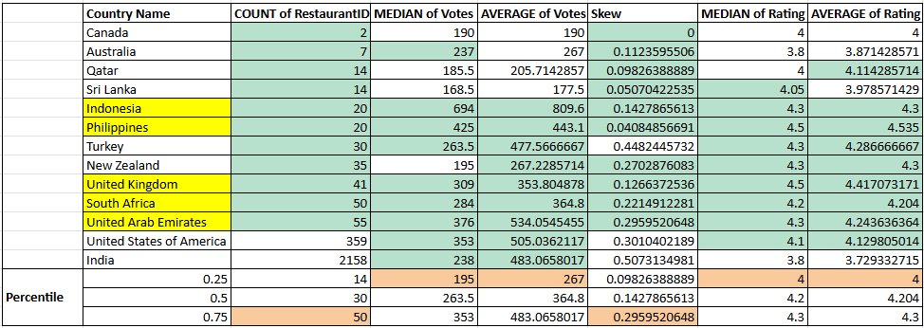
Countries were scored on the basis of restaurant count, votes and rating.
Only restaurants with votes>100 are considered for ranking.
POTENTIAL CITIES
Having narrowed down the countries, we zoomed into the cities. What we discovered was powerful: a handful of cities with strong customer love but little competition. These are the hidden gems the data whispered to us.
The final shortlisted cities included Tangerang, Pasig City, Pasay City, Makati City, Taguig City, San Juan City, Mandaluyong City, Randburg, Johannesburg, Sandton, Inner City, Dubai, Manchester, Edinburgh, and Birmingham offering the right mix of engagement and opportunity.

Slide 9
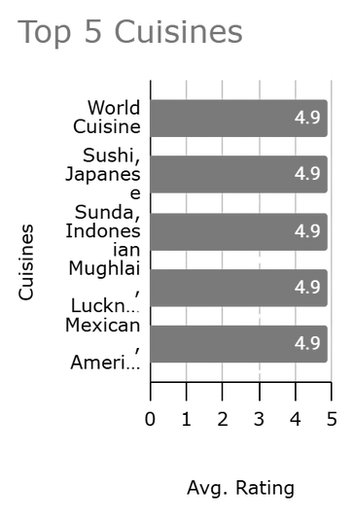

CUISINE
The next question was what do customers actually love eating? The data spoke again showing that customers reward moderate variety and top-rated cuisines. In fact, offering just the right number of options can make or break a dining experience.
In the five shortlisted countries, while top-rated cuisines remained consistent, restaurants offering more than four cuisines were relatively rare, indicating an opportunity to fill that gap.
A mix of globally loved cuisines and region-specific favorites appears to create the most favorable perception among diners.
The number of cuisines offered seem to play a key role here. They tend to form a positive correlation. Cuisine count of 6 seems to be the best rated.
Restaurants that offered 4 to 6 cuisines had the highest average ratings, suggesting that a moderate variety appeals to customers more than overly focused or overly broad menus.
Design menus with 4–6 curated cuisines to balance diversity and focus, maximizing customer satisfaction without overwhelming the kitchen or diners.
Avoid excessive menu diversification especially offering more than 6 cuisines, unless it's part of a large-format or buffet-style concept.
Introduce underrepresented but highly rated cuisines in new markets, which can become a competitive differentiator.

Slide 10
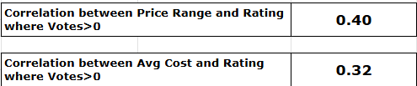
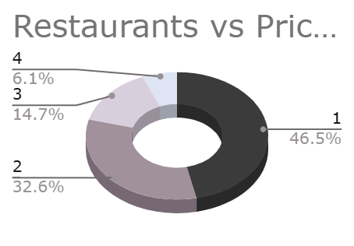
PRICING
Pricing isn't just about affordability it's about perception. The data shows that when customers pay more, they expect more and they reward quality with better ratings. So the key question isn't “how cheap?” but “how valuable does it feel?”
A moderate positive correlation of 0.40 was found between Price Range and Rating, indicating that restaurants in higher pricing tiers tend to receive better customer ratings.
A weaker but still noticeable correlation of 0.32 was observed between Average Cost (INR) and Rating, suggesting that higher actual cost can also contribute positively to customer perception — although not as strongly as relative price tiering.
This indicates that perceived value within a price category (e.g., mid-range vs. premium) plays a bigger role in influencing satisfaction than the absolute amount spent.
The findings confirm that customers are generally willing to pay more, but expect quality, ambiance, and service consistency in return.
New restaurants should be strategically positioned in the moderate-to-premium pricing tiers (Price Range 3–4) to benefit from the stronger correlation with positive ratings.
Avoid underpricing (Price Range 1–2) unless the offering clearly targets a value-driven market segment with limited expectations.
Highlight value propositions and the offerings to justify higher price points and attract higher ratings.

Slide 11
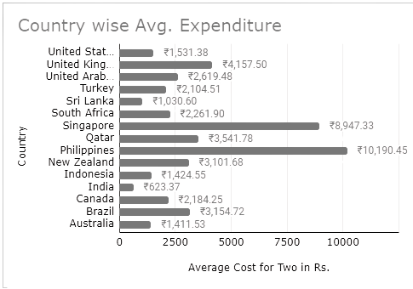
Once we understood that perceived value drives satisfaction, the next question was how much are people actually spending in different countries?
By converting all price data into INR, we created a common ground helping us price strategically in each market based on local customer expectations and spending behavior.
Conversion of Average Cost for Two into INR revealed major variations across countries.
Countries like UAE, UK, South Africa showed higher average spend levels, making them ideal for premium positioning.
Philippines and Indonesia reflected moderate spending, supporting value-for-money or aspirational mid-range offerings.
These cost figures offer a valuable lens to understand local affordability and pricing sensitivity, helping fine-tune entry-level offerings per region.
In Indonesia, consider launching affordable, value-driven concepts with high table turnover and efficient service to align with local pricing expectations.
In South Africa and UAE, position new restaurants at a mid-premium price point, ensuring quality justifies price while maintaining accessibility.
For the United Kingdom, adopt a premium pricing strategy but complement it with strong branding to meet higher customer expectations.
For the Philippines target high-income urban areas with luxury offerings, else recalibrate pricing models based on more refined segments.

Slide 12
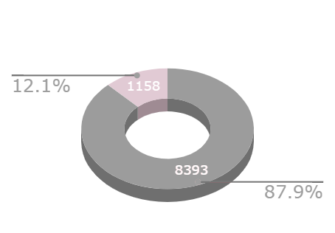
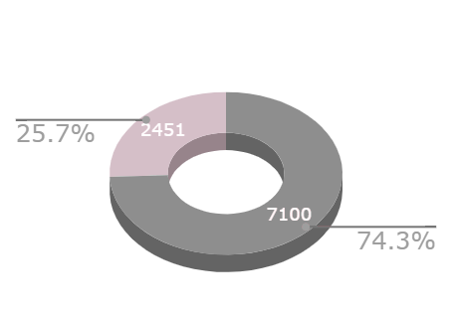
ESSENTIAL FEATURES
The data also showed us what works beyond food: online delivery, table booking, and mid-premium pricing. These aren’t just services — they’re signals of convenience and quality that customers respond to.
Both online delivery and table booking should be enabled for all new restaurant launches, as the combination yields the highest customer satisfaction scores.
If operational constraints exist, prioritize implementing at least one of the two.
These features are not only expected by modern diners but also act as trust signals that enhance brand perception and visibility on platforms like Zomato.

Slide 13

MARKET ENTRY STRATEGY
By now, the story had written itself based entirely on what the data revealed. We've listened closely to what the data told us and it spoke with clarity. Some countries are crowded, others quiet but promising. What emerged was a shortlist of markets that are not only ready, but waiting for a new kind of dining experience.
UNDERSERVED HIGH-POTENTIAL COUNTRIES
HIGH-ENGAGEMENT CITY
OPPORTUNITY
AVOID SATURATED MARKETS
CAPITALIZE ON FIRST MOVER ADVANTAGE
Focus on Indonesia, Philippines, UK, South Africa, and UAE, where restaurant density is low but customer satisfaction and engagement are high, making them prime markets for new entries.
Prioritize specific cities such as Tangerang, Pasig City, Makati, Randburg, Edinburgh, and Manchester, which have high average ratings, sufficient customer engagement (votes > 100), and manageable restaurant density.
Defer entry into highly saturated markets like India and the USA, unless launching with a unique, niche, or innovation-based concept that offers clear differentiation from existing players.
Establish presence in emerging urban centers early, to build brand recognition and loyalty before competitors scale into these high-potential regions.

Slide 14



SERVICE & PRICING STRATEGY
Beyond location, it’s the experience that defines success. And the data was clear: when customers find value, convenience, and trust they reward it with loyalty. Let’s look at how pricing and service design can elevate satisfaction and boost visibility.
Enable both online delivery and table booking features from the start
Data showed restaurants offering these features had higher average ratings
Target a Price Range of 3
A correlation of 0.40 between price and rating indicates customers are willing to pay more when the perceived value is high
Avoid low pricing tiers (Price Range 1–2) unless entering with a value-oriented strategy
These segments showed lower average ratings and customer satisfaction

Slide 15



DESIGNING MENUS THAT WIN
What’s on the plate matters just as much as where the table is. The top-rated restaurants didn’t just serve food, they served the right food. And in markets where competitors are falling short, the opportunity to disrupt and delight is wide open.
Mission
CUISINES
Design menus with 4–6 curated cuisines to balance diversity and focus, maximizing customer satisfaction without overwhelming the kitchen or diners.
Avoid excessive menu diversification especially offering more than 6 cuisines
Mission
COMPETITIONS
Zomato’s expansion should benchmark against proven competitors in each region while introducing differentiators whether that’s speed, convenience, sustainability, or digital-first service.
At the same time, targeting markets with weak incumbents opens the door to reclaim dissatisfied diners and build brand loyalty from day one.

Slide 16
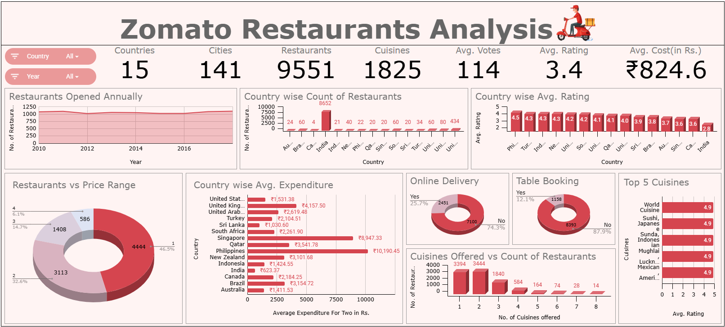
DASHBOARD
All these insights came together not just in slides, but in a tool; a dashboard where anyone can explore, analyze, and decide.
It’s where the data continues to speak, live, interactive, and ready for real-time strategy.

Slide 17
CONCLUSION
This project demonstrates how structured data analysis can drive meaningful business decisions in the restaurant industry. Through a mix of pivot tables, filtering techniques, segmentation logic, and custom formulas, we transformed a complex raw dataset into clear insights and strategic actions.
Key findings include:
the identification of high-potential markets such as Indonesia, Philippines, South Africa, UK and the UAE
the influence of features like delivery and booking on ratings and
the value of targeted pricing and curated cuisine strategies.
By combining statistical rigor with interactive visuals, the project not only answers immediate business questions but also lays the groundwork for scalable, data-backed expansion strategies in emerging and mature markets alike.
From scattered rows to strategic clarity, this journey wasn’t about opinions it was about listening to data. What we found was a roadmap built on signals, patterns, and proof. Now, the story the data told us is ready to become action.
The result is a set of actionable insights delivered through a comprehensive, interactive dashboard that aligns with Zomato’s mission to bring better food for more people - thoughtfully, strategically, and efficiently.

